Slide 1
Useful notes
Particle Codes:
p 2212
n 2112
γ 22
Nuclear Codes- 10LZZZAAAI
1000060140 -Nitrogen
1000070140 - Carbon
1000260560 - Iron
G_4 Galactic: Density=1e-25 g/cm^3
G_4 Stainless_Steel: Density= 8 g/cm^3
Key:
Pink- hIoni
B - hadElastic
Y - NeutronInelastic
R - IonIoni
G - Photoelectric

Slide 2
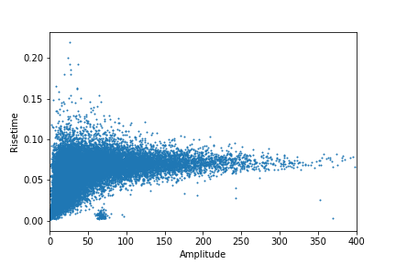
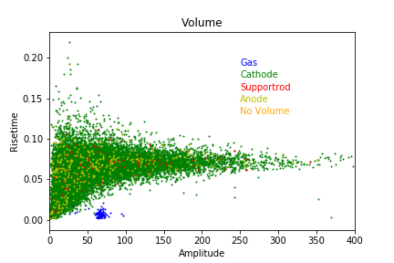
Sphere type | Number of Neutrons | Initial Position | Initial Direction
Steel | 500000 | 14.99 0 0 | 0 0 0
Total number of interacting events:21533
Obtained much more statistics to compare against the experimental data

Slide 3
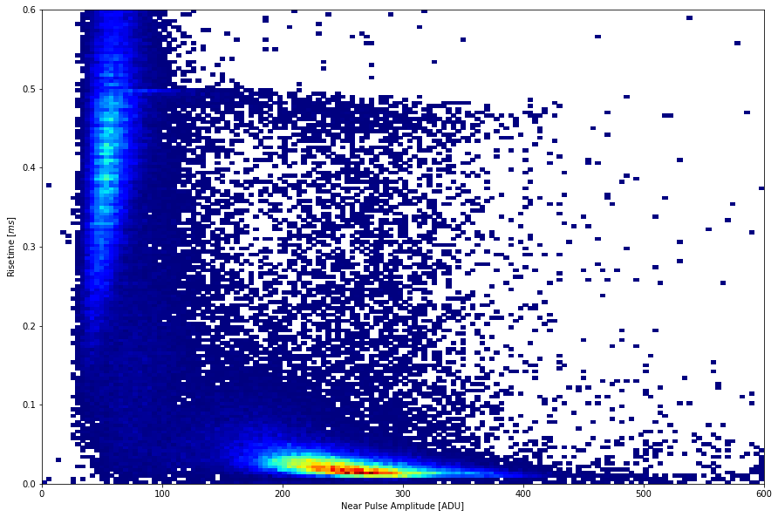
The experimental plot have events removed that are triggering within the thermal cuts on the other channel.
Experimental
Simulation
Can see similar regions in both the experimental and simulation plots. However this is made difficult with the overflow region caused by tango.
Notes:
Zoomed in version behind the plot

Slide 4
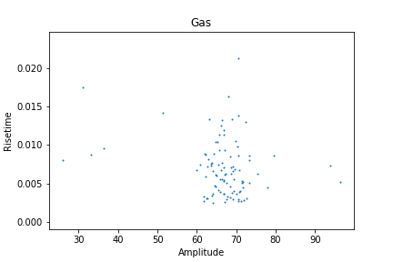
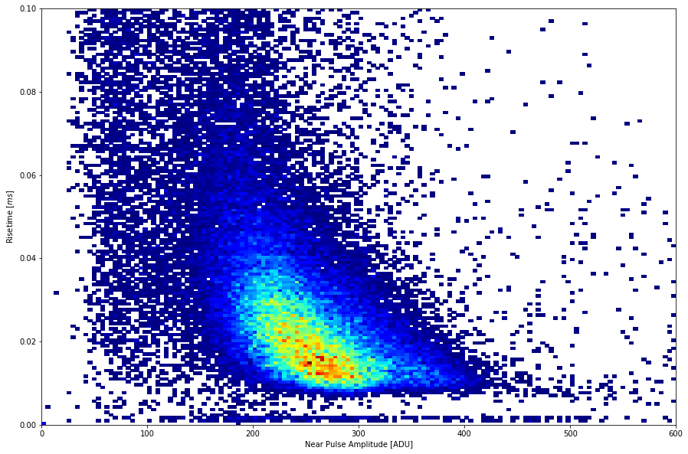
26218
2725
46749
The rise time on the experimental data goes much higher than in the simulation data
Neutrons interacting within the gas
Using volume to estimate efficiency:
Number events: 97
Efficiency: 1.94e-04 +- 0.19e-04
Notes:
69 5.9
uncert

Slide 5
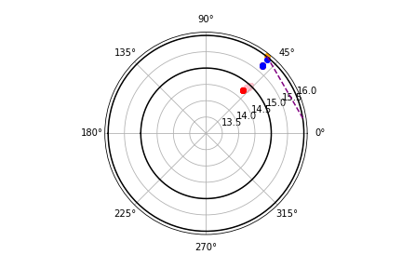
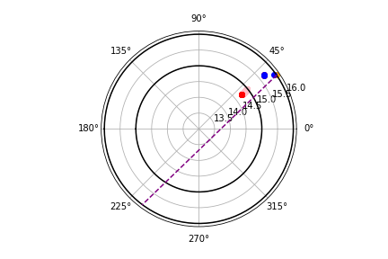
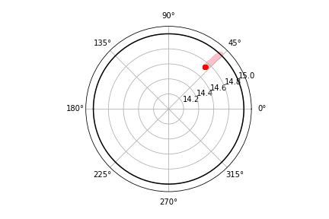
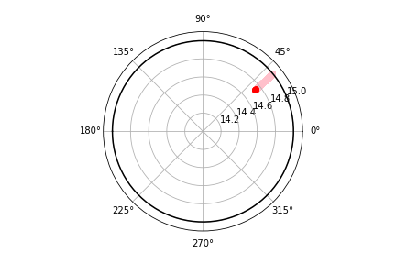
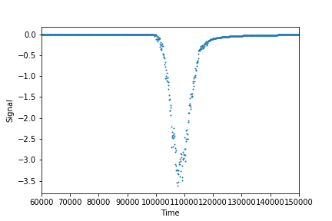
26218
Primary ,Cathode,hadElastic,2112.000000,15.951445,0.810887,0.879531,0.000000,0.000000
Primary ,Cathode,hadElastic,2112.000000,15.700617,0.771271,0.881232,0.000000,0.000000
Primary ,Cathode,hadElastic,2112.000000,15.680139,0.771745,0.873217,0.000000,0.000000
Primary ,Gas,neutronInelastic,2112.000000,14.747446,0.780916,0.855158,0.000000,0.000000
Secondary Gas,ionIoni,1000060140.000000,14.743165,0.781178,0.855660,1.000000,0.015691
Secondary Gas,ionIoni,1000060140.000000,14.739445,0.781425,0.855720,1.000000,0.012969
Secondary Gas,ionIoni,1000060140.000000,14.738659,0.781588,0.855420,1.000000,0.010873
Secondary Gas,ionIoni,1000060140.000000,14.738456,0.781613,0.855401,1.000000,0.002611
Secondary Gas,ionIoni,1000070140.000000,14.738301,0.781612,0.855399,6.000000,0.000001
Secondary Gas,hIoni,2212.000000,14.748504,0.780869,0.855001,1.000000,0.000365
Secondary Gas,hIoni,2212.000000,14.749628,0.780819,0.854833,1.000000,0.000452
.
Secondary Gas,hIoni,2212.000000,14.999828,0.769777,0.821766,1.000000,0.000003
Secondary Gas,Transportation,2212.000000,15.000000,0.769769,0.821743,1.000000,0.000000
Secondary Cathode,hIoni,2212.000000,15.000001,0.769769,0.821743,1.000000,0.001524
Secondary Cathode,hIoni,2212.000000,15.000001,0.769769,0.821743,1.000000,0.000000
Secondary Cathode,hIoni,2212.000000,15.000001,0.769769,0.821743,1.000000,0.001241
Phi
Theta

Slide 6
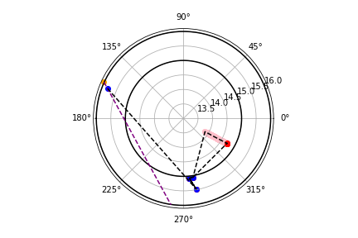
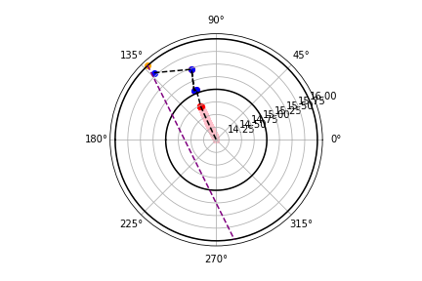
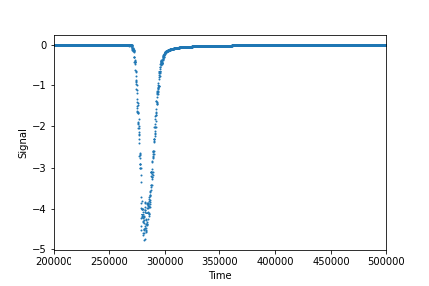
2725
Primary ,Cathode,hadElastic,2112.000000,15.808456,-0.678851,2.765236,0.000000,0.000000
Primary ,Cathode,hadElastic,2112.000000,15.478783,-0.331053,-1.392659,0.000000,0.000000
Primary ,Cathode,hadElastic,2112.000000,15.072726,-0.408828,-1.473551,0.000000,0.000000
Primary ,Cathode,hadElastic,2112.000000,15.057722,-0.371244,-1.411000,0.000000,0.000000
Primary ,Gas,neutronInelastic,2112.000000,14.721642,-0.421798,-0.521220,0.000000,0.000000
Secondary Gas,ionIoni,1000060140.000000,14.728144,-0.421575,-0.520865,1.000000,0.015067
Secondary Gas,ionIoni,1000060140.000000,14.733730,-0.421407,-0.520622,1.000000,0.012016
Secondary Gas,ionIoni,1000060140.000000,14.737107,-0.421229,-0.520428,1.000000,0.008462
Secondary Gas,ionIoni,1000060140.000000,14.737481,-0.421101,-0.520334,1.000000,0.006536
Secondary Gas,ionIoni,1000070140.000000,14.737695,-0.421097,-0.520326,7.000000,0.000001
Secondary Gas,hIoni,2212.000000,14.721596,-0.421799,-0.521221,1.000000,0.000000
Secondary Gas,hIoni,2212.000000,14.719644,-0.421854,-0.521278,1.000000,0.000052
.
Secondary Gas,hIoni,2212.000000,13.871785,-0.447417,-0.551665,1.000000,0.012782
Secondary Gas,hIoni,2212.000000,13.870476,-0.447525,-0.551622,1.000000,0.002668
Secondary Cathode,ionIoni,1000260560.000000,15.057722,-0.371244,-1.411000,1.000000,0.000000
Secondary Cathode,ionIoni,1000260560.000000,15.072726,-0.408828,-1.473551,1.000000,0.000000
Secondary Cathode,ionIoni,1000280600.000000,15.478783,-0.331053,-1.392659,1.000000,0.000000
Secondary Cathode,ionIoni,1000260560.000000,15.808456,-0.678851,2.765236,1.000000,0.000000
Phi
Theta
Notes:
This has a high rise time due to the nature of the ionising track which is directed to the center of the detector. Resulting in a greater difference between the arrival of the electrons at the anode.

Slide 7
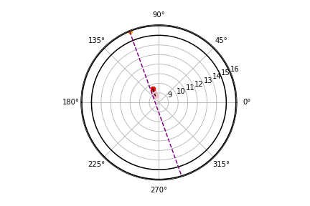
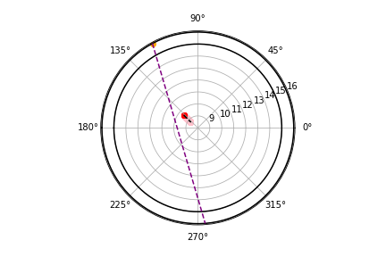
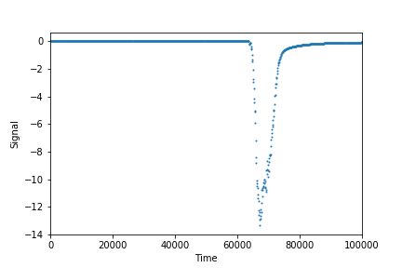
46749
Primary ,Gas,neutronInelastic,2112.000000,9.585504,-0.404258,2.398825,0.000000,0.000000
Secondary Gas,ionIoni,1000060140.000000,9.590651,-0.403705,2.398344,1.000000,0.020489
Secondary Gas,ionIoni,1000060140.000000,9.589709,-0.403428,2.397716,1.000000,0.013525
Secondary Gas,ionIoni,1000060140.000000,9.588321,-0.403344,2.397411,1.000000,0.008118
Secondary Gas,ionIoni,1000070140.000000,9.588050,-0.403363,2.397428,3.000000,0.000003
Secondary Gas,hIoni,2212.000000,9.584361,-0.404340,2.398884,1.000000,0.000838
Secondary Gas,hIoni,2212.000000,9.583661,-0.404391,2.398920,1.000000,0.000118
.
Secondary Gas,hIoni,2212.000000,8.778074,-0.463384,2.453782,1.000000,0.000203
Secondary Gas,hIoni,2212.000000,8.778294,-0.463406,2.453750,1.000000,0.000220
Secondary Gas,hIoni,2212.000000,8.778240,-0.463392,2.453743,1.000000,0.000985
Phi
Theta

Slide 8
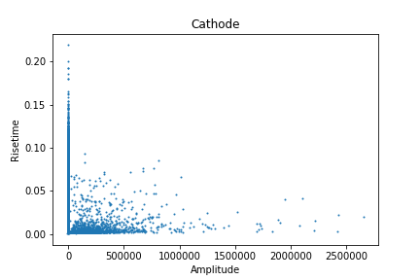

Cathode
Using volume to estimate efficiency:
Number events: 21434
Efficiency: 4.29e-02

Slide 9
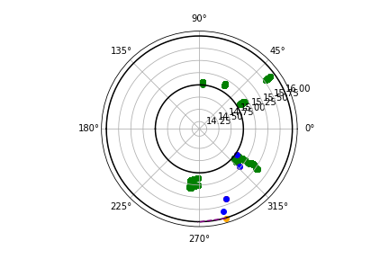
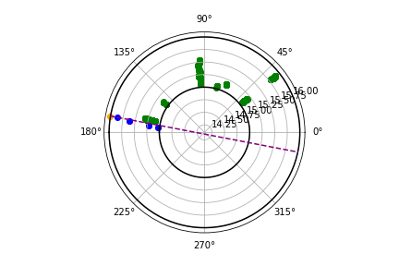
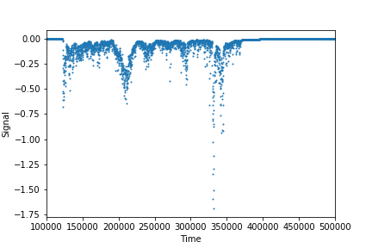
297854
Primary ,Cathode,hadElastic,2112.000000,15.858609,-0.984598,-1.284937,0.000000,0.000000
Primary ,Cathode,hadElastic,2112.000000,15.622706,-0.988526,-1.203349,0.000000,0.000000
Primary ,Cathode,hadElastic,2112.000000,15.223502,-0.992713,-0.753675,0.000000,0.000000
Primary ,Cathode,hadElastic,2112.000000,15.032525,-0.995047,-0.606110,0.000000,0.000000
Primary ,Cathode,nCapture,2112.000000,15.227390,-0.090759,-0.621013,0.000000,0.000000
Secondary Cathode,ionIoni,1000260570.000000,15.227390,-0.090759,-0.621013,1.000000,0.000627
Secondary Cathode,compt,22.000000,15.272646,-0.092278,-0.616657,1.000000,0.000038
Secondary Cathode,phot,22.000000,15.312073,-0.974000,-1.722038,13.000000,0.000013
Secondary Cathode,phot,22.000000,15.312071,-0.974000,-1.722038,1131.000000,0.000013
Secondary Cathode,phot,22.000000,15.312036,-0.974001,-1.722044,13.000000,0.000082
Secondary Cathode,phot,22.000000,15.312037,-0.974001,-1.722043,1136.000000,0.000025
.
Secondary Cathode,phot,22.000000,15.346843,-0.089832,-0.604257,24927.000000,0.000013
Secondary Cathode,ionIoni,1000280580.000000,15.032525,-0.995047,-0.606110,1.000000,0.000000
Secondary Cathode,ionIoni,1000260560.000000,15.223502,-0.992713,-0.753675,1.000000,0.000000
Secondary Cathode,ionIoni,1000280620.000000,15.622706,-0.988526,-1.203349,1.000000,0.000000
Secondary Cathode,ionIoni,1000260560.000000,15.858609,-0.984598,-1.284937,1.000000,0.000000
Phi
Theta
Notes:
23.408018 amp
199.87938 rt

Slide 10
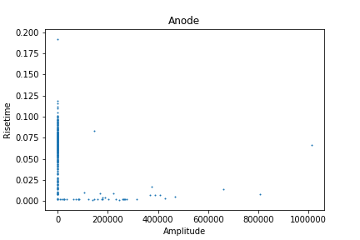
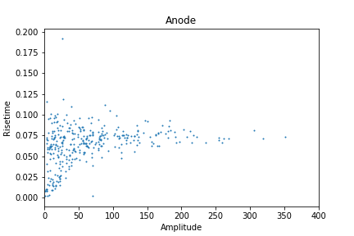
Anode
Using volume to estimate efficiency:
Number events: 382
Efficiency: 7.64e-04

Slide 11
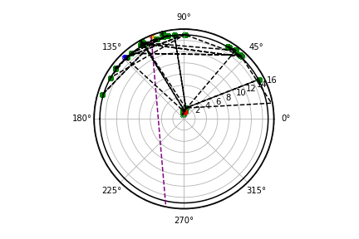
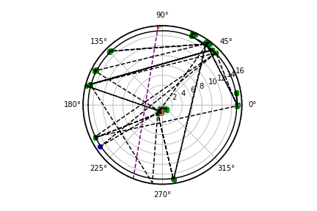
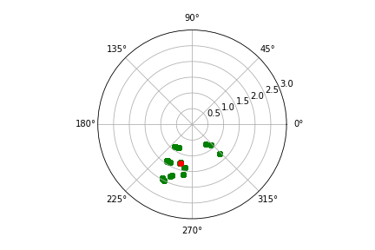
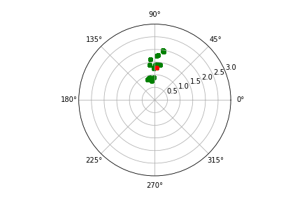
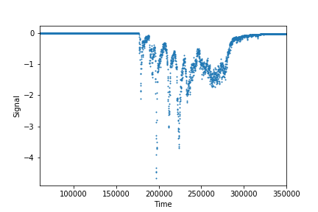
9699
Phi
Theta
Data file can be found here https://drive.google.com/file/d/1aDCO3tn4y51kWquAgdmGs-DDyGOa-ckN/view?usp=sharing
There are both interaction occurring at the anode and at the cathode so the events printed are switching between these volumes
In brief, neutron scatters in the cathode, then hitting the anode producing gamma which then scatters within the anode. You then also get gammas that are scattering within the cathode with the occasional event within the anode.
Notes:
108.74782 amp
71.61043 rt

Slide 12
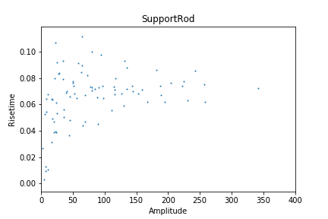
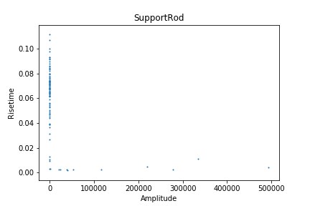
Support Rod
139197
Using volume to estimate efficiency:
Number events: 95
Efficiency: 1.90e-04

Slide 13
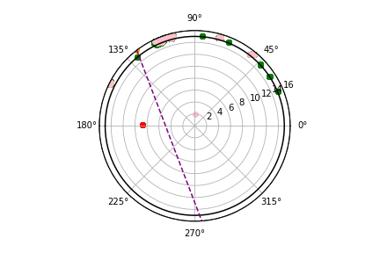
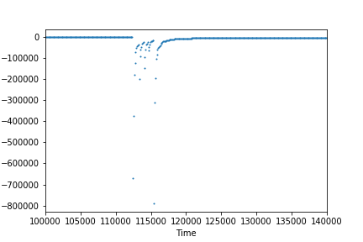
139197
Data file can be found here https://drive.google.com/file/d/1kPkYwBC_ymYbzDTl9l41zwSWQMzOgcMG/view?usp=sharing
This event has a very high amplitude and has an unusual signal.
The neutron hits the support rod and has interactions in the support rod, anode and cathode.
Theta
Key:
Pink- compt
B - hadElastic
Y - NeutronCapture
R - IonIoni
G - Photoelectric

Slide 14
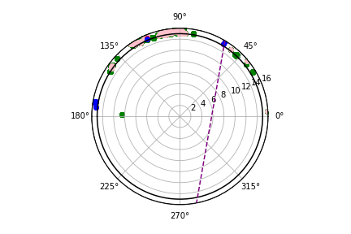
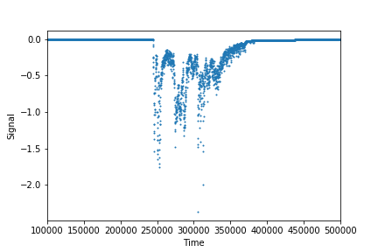
186643
Data file can be found here https://drive.google.com/file/d/1cHuPHhkZrGrcDrsXMkZKMuQD7krKAOeL/view?usp=sharing
Here the majority of the hits are found within the cathode however there are number hits produced by gammas within the support rod.
Theta
Key:
Pink- compt
B - hadElastic
Y - NeutronCapture
R - IonIoni
G - Photoelectric
Notes:
34.277924 amp
79.00719 rt

Slide 15
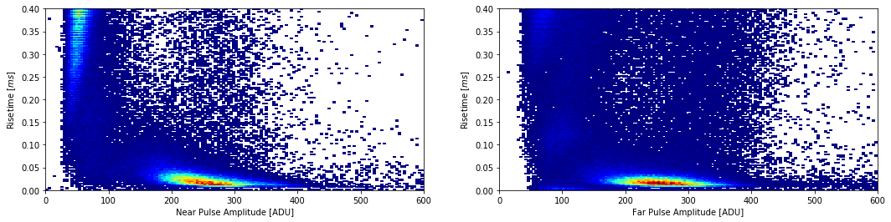
Experimental Comparisons
Here the amplitude is much bigger than the simulation. This will have to be checked with the pre amp settings of the simulation

Slide 16
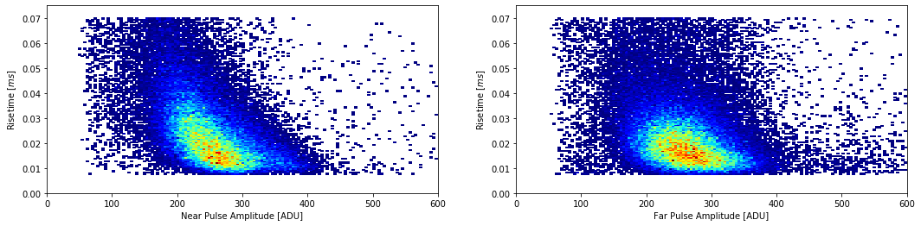
Experimental after cuts
Efficiency =

Slide 17
Summary
Regions produced in the simulation match up to the experimental data.
However there are differences with the rise time and amplitude.
There are also a number of large amplitude points produced by the simulation that are not found within the experimental data.
We track the particles through the detector when the kinetic energy of the tracked particle changes. However this is done for electrons due to the large amount of memory required.

